Slide 1
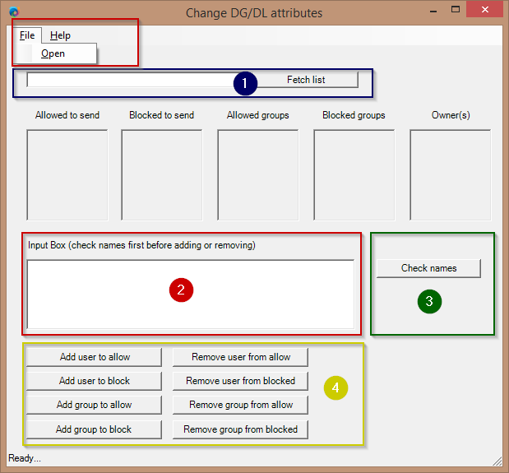
Quick Reference Card - Change DG/DL attributes
No | Action
1 | Enter the name of the list (e.g. West-site, Engineering-staff) and click Fetch List
2 | Type the samaccountname of the user or group you want to add or remove (or use File – Open to open a .csv file with the samaccountnames)
3 | Click Check Names to verify the names in Active Directory
4 | Use any of the corresponding user or group action buttons to change the list (the list will automatically reload)

